Slide 1
CME 2003 Digital Logic
MEMORY

Slide 2
Lecture 8 Memory
Basics
Memory Hierarchy
Data Transfer
Memory Unit
Read/Write Operations
Memory Cell
Memory Array
CEM122
Memory

Slide 3
Basics
Memory stores programs and data.
Definitions:
  1 byte = 8 bits
  1 word: in multiple of bytes; a unit of transfer between main memory and registers, usually size of register.
  1 KB (kilo-bytes) = 2¹⁰ bytes; 1 MB (mega-bytes) = 2²⁰ bytes; 1 GB (giga-bytes) = 2³⁰ bytes; 1TB (tera-bytes) = 2⁴⁰ bytes.
Desirable properties: fast access, large capacity, economical cost, non-volatile.
However, most memory devices do not possess all these properties.
CEM122
Memory

Slide 4
Memory Hierarchy
Fast, expensive (small numbers), volatile
registers
cache memory
main memory
disk storage
Slow, cheap (large numbers), non-volatile
magnetic tapes
CEM122
Memory

Slide 5
Data Transfer (1/2)
Address
Memory
Up to 2^{k} addressable locations.
0
1
2
3
4
5
Processor
k-bit address bus
MAR
n-bit data bus
MDR
:
Control lines
(R/W, etc.)
CEM122
Memory

Slide 6
Data Transfer (2/2)
A memory unit stores binary information in groups of bits called words.
The data consists of n lines (for n-bit words). Data input lines provide the information to be stored (written) into the memory, while data output lines carry the information out (read) from the memory.
The address consists of k lines which specify which word (among the 2^{k} words available) to be selected for reading or writing.
The control lines Read and Write (usually combined into a single control line Read/Write) specifies the direction of transfer of the data.
CEM122
Memory

Slide 7
Memory Unit
Block diagram of a memory unit:
n data input lines
n
k
Memory unit
2^{k} words
n bits per word
k address lines
Read/Write
n
n data output lines
CEM122
Memory

Slide 8
Read/Write Operations (1/2)
The Write operation:
  Transfers the address of the desired word to the address lines.
  Transfers the data bits (the word) to be stored in memory to the data input lines.
  Activates the Write control line (set Read/Write to 0).
The Read operation:
  Transfers the address of the desired word to the address lines.
  Activates the Read control line (set Read/Write to 1).
CEM122
Memory

Slide 9
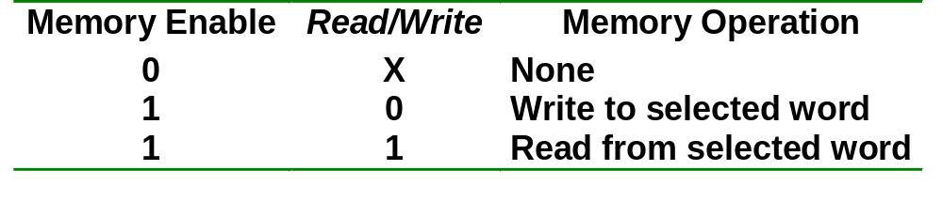
Read/Write Operations (2/2)
The Read/Write operation:
Two types of RAM: Static and dynamic.
  Static RAMs use flip-flops as the memory cells.
  Dynamic RAMs use capacitor charges to represent data. Though simpler in circuitry, they have to be constantly refreshed.
CEM122
Memory

Slide 10
Memory Cell
A single memory cell of the static RAM has the following logic and block diagrams:
Select
Select
R
S
Input
Q
Output
Input
BC
Output
Read/Write
Read/Write
Logic diagram
Block diagram
CEM122
Memory

Slide 11
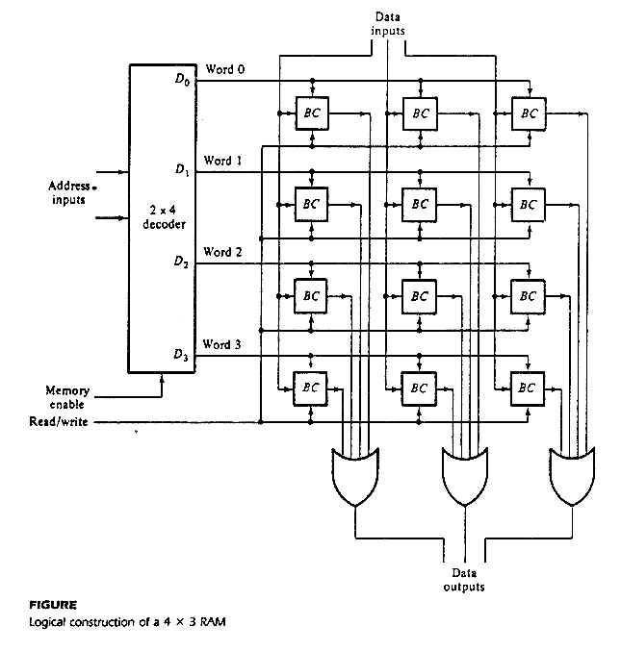
Memory Array (1/4)
Logic construction of a 4 x 3 RAM (with decoder and OR gates):
CEM122
Memory

Slide 12
Memory Array (2/4)
An array of RAM chips: memory chips are combined to form larger memory.
A 1K x 8-bit RAM chip:
RAM 1K x 8
Input data
Address
Chip select
Read/write
8
DATA (8)
ADRS (10)
CS
RW
(8)
8
Output data
10
Block diagram of a 1K x 8 RAM chip
CEM122
Memory

Slide 13
Memory Array (3/4)
Address
Input data
Lines
Lines
8 lines
11 10
0 – 9
0–1023
DATA (8)
ADRS (10)
CS
RW
(8)
2x4 decoder
1K x 8
S₀
S₁
0
1
2
3
1024 – 2047
DATA (8)
ADRS (10)
CS
RW
(8)
1K x 8
2048 – 3071
Read/write
DATA (8)
ADRS (10)
CS
RW
(8)
1K x 8
3072 – 4095
4K x 8 RAM.
DATA (8)
ADRS (10)
CS
RW
(8)
1K x 8
Output data
CEM122
Memory

Slide 14
Memory Array (4/4)
21-bit
A
addresses
19-bit internal chip address
A
0
1
A
19
A
20
2-bit
decoder
512K x 8 memory chip
512k X 8
memory chip
D
D
D
D
31-24
23-16
15-8
7-0
19-bit
address
8-bit data
input/output
Another example:
Organization of a 2M × 32 memory module using 512K × 8 static memory chips.
Chip select
CEM122
Memory

Slide 15
End of file
CEM122
Memory

